Slide 1

RV College of Engineering
Go, change the world
“Recent trends in Food Packaging”
Dr Trilokchandran B
Asst.Professor,
Department of Biotechnology
R V COLLEGE OF ENGINEERING
BENGALURU-560059

Slide 2
R V College of Engineering
Agenda
Introduction
Theory of packing
Smart packing
Creative packing
Conclusions

Slide 3
Introduction to packaging
R V College of Engineering
Packaging means the wrapping or bottling of products to make them safe from damages during transportation and storage. It keeps a product safe and marketable and helps in identifying, describing, and promoting the product. “Packing is the preparation of product or commodity for proper storage and/or transportation.

Slide 4

R V College of Engineering
Packaging FACTORS considered
1960…convenience
1970…light weight
1980…source reduction, energy saving
tamper evidence
1990 onwards…environmental impact
is considered

Slide 5

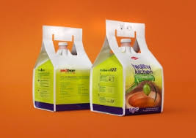
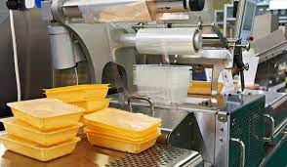
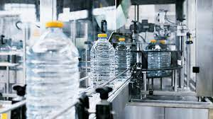
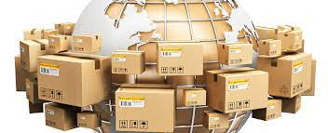
RV College of Engineering
Go, Change The World
Art, Science and Technology
involves in Packaging

Slide 6
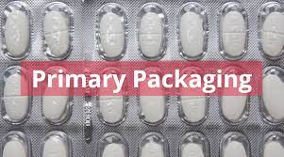
RV College of Engineering
Go, Change The World
Packaging exists at different levels
Primary packaging includes not just the materials in direct contact with the product, but all of the packaging which surrounds the product when the consumer takes it home. For a multipack of crisps, for example, the primary packaging will be the individual bags and the large bag into which the separate packs are packed.
A useful way to define primary packaging is to think of it as all the packaging which eventually finds its way into the domestic waste stream, once the product is used up.

Slide 7
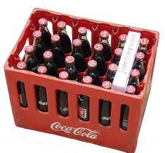
RV College of Engineering
Go, Change The World
Secondary packaging is used to group packs together for ease of handling.
In the example above of the crisps, several multipacks are packed into printed corrugated cases. The case is the secondary packaging. Other examples of secondary packaging are shrink-wrap film, and the corrugated board and thermoformed plastic trays used for shelf-ready packaging.

Slide 8
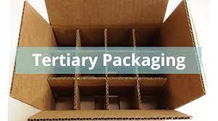
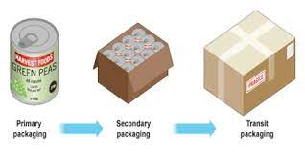
RV College of Engineering
Go, Change The World
Tertiary packaging is used to collate secondary packs for ease of transport.
One of the most common forms of tertiary packaging is the pallet, along with stretch wrap film and a label, to secure the secondary packs to the pallet and provide a ready means of identification. Roll cages and crates are also examples of tertiary packaging.

Slide 9
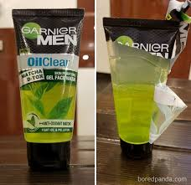
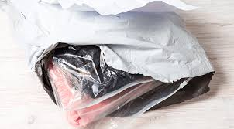
RV College of Engineering
Go, Change The World
Poor basic packaging design significantly increases the risk of shrinkage.
Badly designed packs are more likely to:
allow their contents to become damaged in transit
cause contamination through leakage
experience product spoilage or damage
contribute to product loss through misidentification
lose of contents
become too ugly to sell
suffer decreased shelf life and consequent reduced sales.

Slide 10
RV College of Engineering
Go, Change The World
Some consequences of poor packing
Spoilage: products that have reached their expiry date or gone beyond agreed temperature parameters and are no longer safe to sell to consumers or staff.
Damages: refers to products that have been damaged during the journey to the shelf and in the general store environment.
Data errors: errors in the recording of product details on company systems.
Pricing errors: losses caused by errors in the way in which goods are priced and sold in the business.
Delivery errors: losses caused by incorrect quantities booked to the store inventory but not physically delivered or transferred.
Scanning Errors: errors occurring at the point of sale leading to a discrepancy in the store book stock.

Slide 11
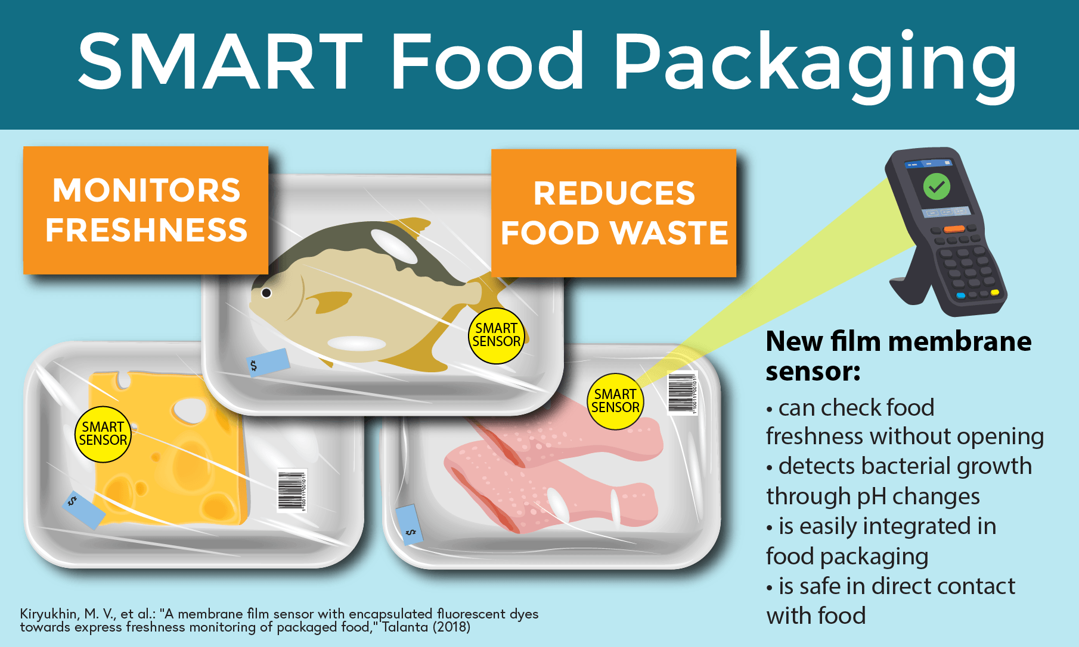
RV College of Engineering
Go, Change The World

Slide 12
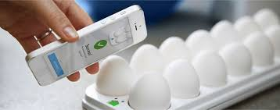
RV College of Engineering
Go, Change The World
SMART FOOD PACKAGING
Retain integrity and actively prevent food spoilage (shelf-life)
Enhance product attributes like look, taste, flavor, aroma etc
Respond actively to changes in product or package environment
Communicate product information, product history or condition to user
Assist with opening and indicate seal Integrity
Confirm product authenticity and act to counter theft.

Slide 13

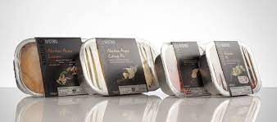
RV College of Engineering
Go, Change The World
MOST
SOPHISTICATED
CONSUMERS

Slide 14


RV College of Engineering
Go, Change The World
INCREASED WORKING WOMEN

Slide 15
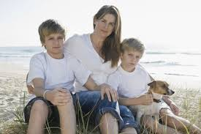



RV College of Engineering
Go, Change The World
SINGLE PARENT,
DUAL INCOME HOUSEHOLD

Slide 16

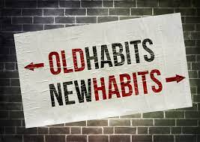
RV College of Engineering
Go, Change The World
LIFE STYLE CHANGE

Slide 17


RV College of Engineering
Go, Change The World
HEALTH CONSCIOUS

Slide 18
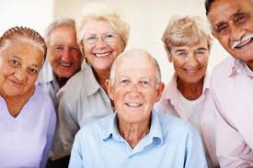


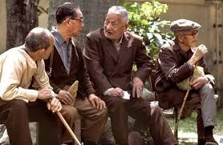
RV College of Engineering
Go, Change The World
AGING POPULATION

Slide 19
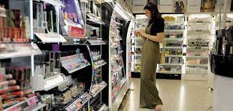



RV College of Engineering
Go, Change The World
EDUCATED AND KNOWLEDGEABLE CONSUMERS

Slide 20
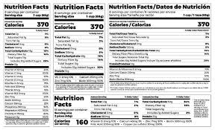
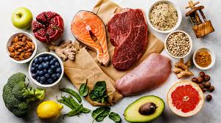
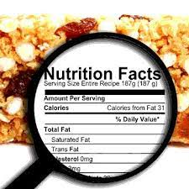
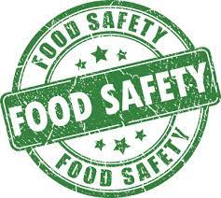
RV College of Engineering
Go, Change The World
NUTRITION, FOOD SAFETY, LABELLING

Slide 21
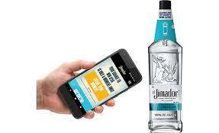


RV College of Engineering
Go, Change The World
Technology-Enabled Solutions
Fibre-based materials
Robotics
Smart packaging
3D printing

Slide 22


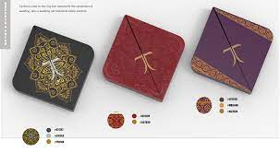
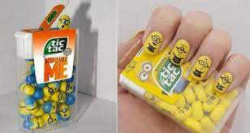
RV College of Engineering
Go, Change The World
Emotional Engagement

Slide 23
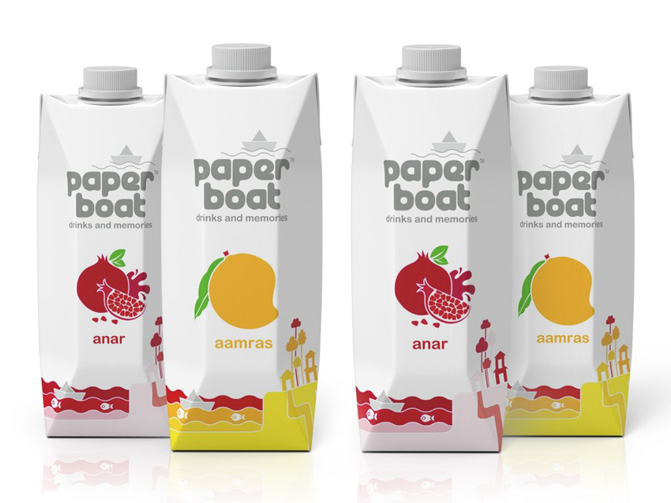
RV College of Engineering
Go, Change The World
Emotional Engagement
Paper Boat images evoke nostalgia. Image Courtesy: www.tetrapak.com

Slide 24
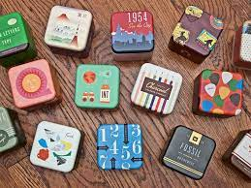
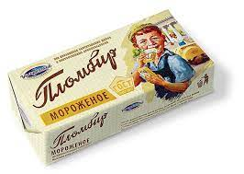
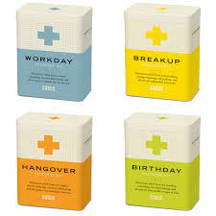
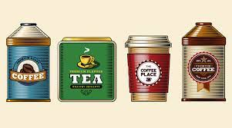
RV College of Engineering
Go, Change The World
Vintage-Inspired Designs

Slide 25
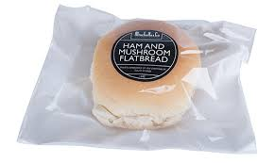
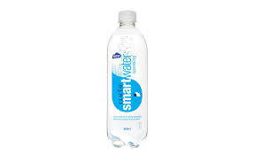
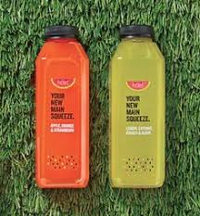
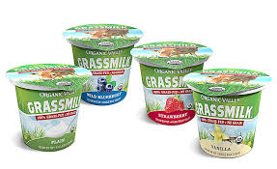
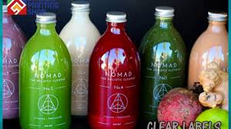
RV College of Engineering
Go, Change The World
Transparent and Clear Labelling

Slide 26
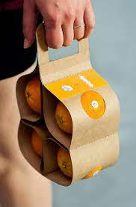
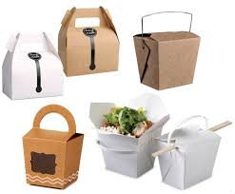
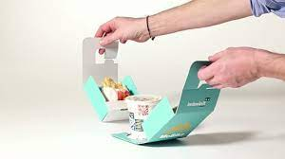
RV College of Engineering
Go, Change The World
Increased Portability

Slide 27
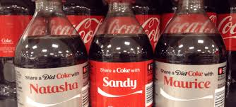
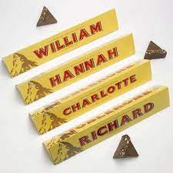
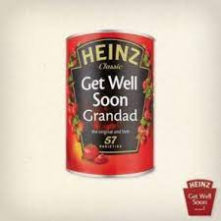
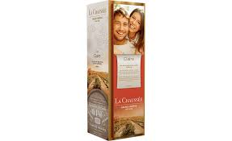
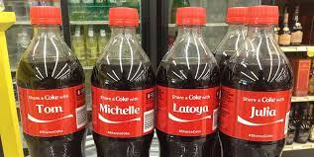
RV College of Engineering
Go, Change The World
Personalization

Slide 28

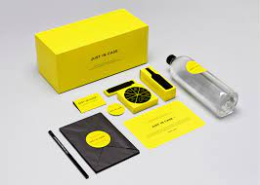

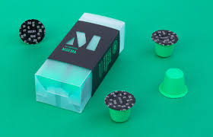
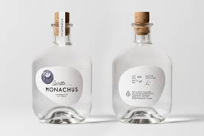
RV College of Engineering
Go, Change The World
Minimal Designs

Slide 29
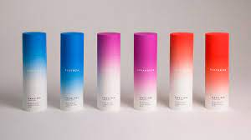
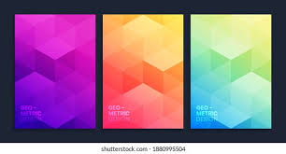
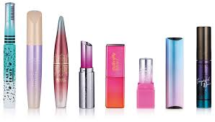
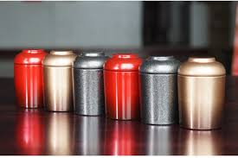
RV College of Engineering
Go, Change The World
Gradient Colouring

Slide 30




RV College of Engineering
Go, Change The World
Sustainability

Slide 31









RV College of Engineering
Go, Change The World
Creative food packaging

Slide 32
RV College of Engineering
Go, Change The World
Creative food packaging
How creative packaging design can elevate a product and make even everyday foodstuffs extraordinary.
Directly correlate to increased sales and brand buzz.

Slide 33


RV College of Engineering
Go, Change The World
Creative packaging designs for rice and pasta
Rice packaging

Slide 34

RV College of Engineering
Go, Change The World
Fresh meat packaging

Slide 35

RV College of Engineering
Go, Change The World
Creative packaging designs soft drinks
Seltzer packaging

Slide 36

RV College of Engineering
Go, Change The World
Creative packaging designs for dairy products
Milk packaging

Slide 37

RV College of Engineering
Go, Change The World
Butter packaging
Mousegraphics of Greece also succeeded in differentiating a dairy brand in a visually overloaded market, but they did it in the opposite way – by stripping away design elements.
They were inspired by the brand’s name smör (which is the Swedish name for ‘butter’), creating a logo that transcribes the initial S to a visual reference to the rolling spires made by a knife on the butter surface. The packaging itself imitates a block of butter with a knob cut off.

Slide 38

RV College of Engineering
Go, Change The World
Creative packaging designs for fast food
Burger packaging

Slide 39

RV College of Engineering
Go, Change The World
Pizza packaging

Slide 40

RV College of Engineering
Go, Change The World
Creative packaging designs for cereal
Cereal multipack packaging

Slide 41

RV College of Engineering
Go, Change The World
Creative packaging designs for food on the go
Salad packaging

Slide 42

RV College of Engineering
Go, Change The World
Creative packaging designs for alcoholic beverages
Wine packaging

Slide 43


RV College of Engineering
Go, Change The World
Creative packaging designs for snacks
Nuts packaging
Dried fruit

Slide 44
RV College of Engineering
Go, Change The World
Oxygen Scavengers
Carbon Dioxide (CO₂) Generators and Scavengers
Ethylene Scavengers

Slide 45






RV College of Engineering
Go, Change The World
Conclusions

Slide 46
THANK YOU

